Slide 1


Church History
The bride’s story
with the Son of GOD

Slide 2


Slide 3
Before church History
“THE WAY” was prepared by the friend of the groom
⁶ There was a man sent from God, whose name was John. ⁷ The same came for a witness, to bear witness of the Light,
that all men through him might believe.
⁸ He was not that Light, but was sent to bear witness of that Light. John 1:6-8
²⁹ He that hath the bride is the bridegroom (Jesus): but the friend of the bridegroom (John the Baptist), which standeth and heareth him, rejoiceth greatly because of the bridegroom's voice: this my joy therefore is fulfilled. John 3:29

Slide 4
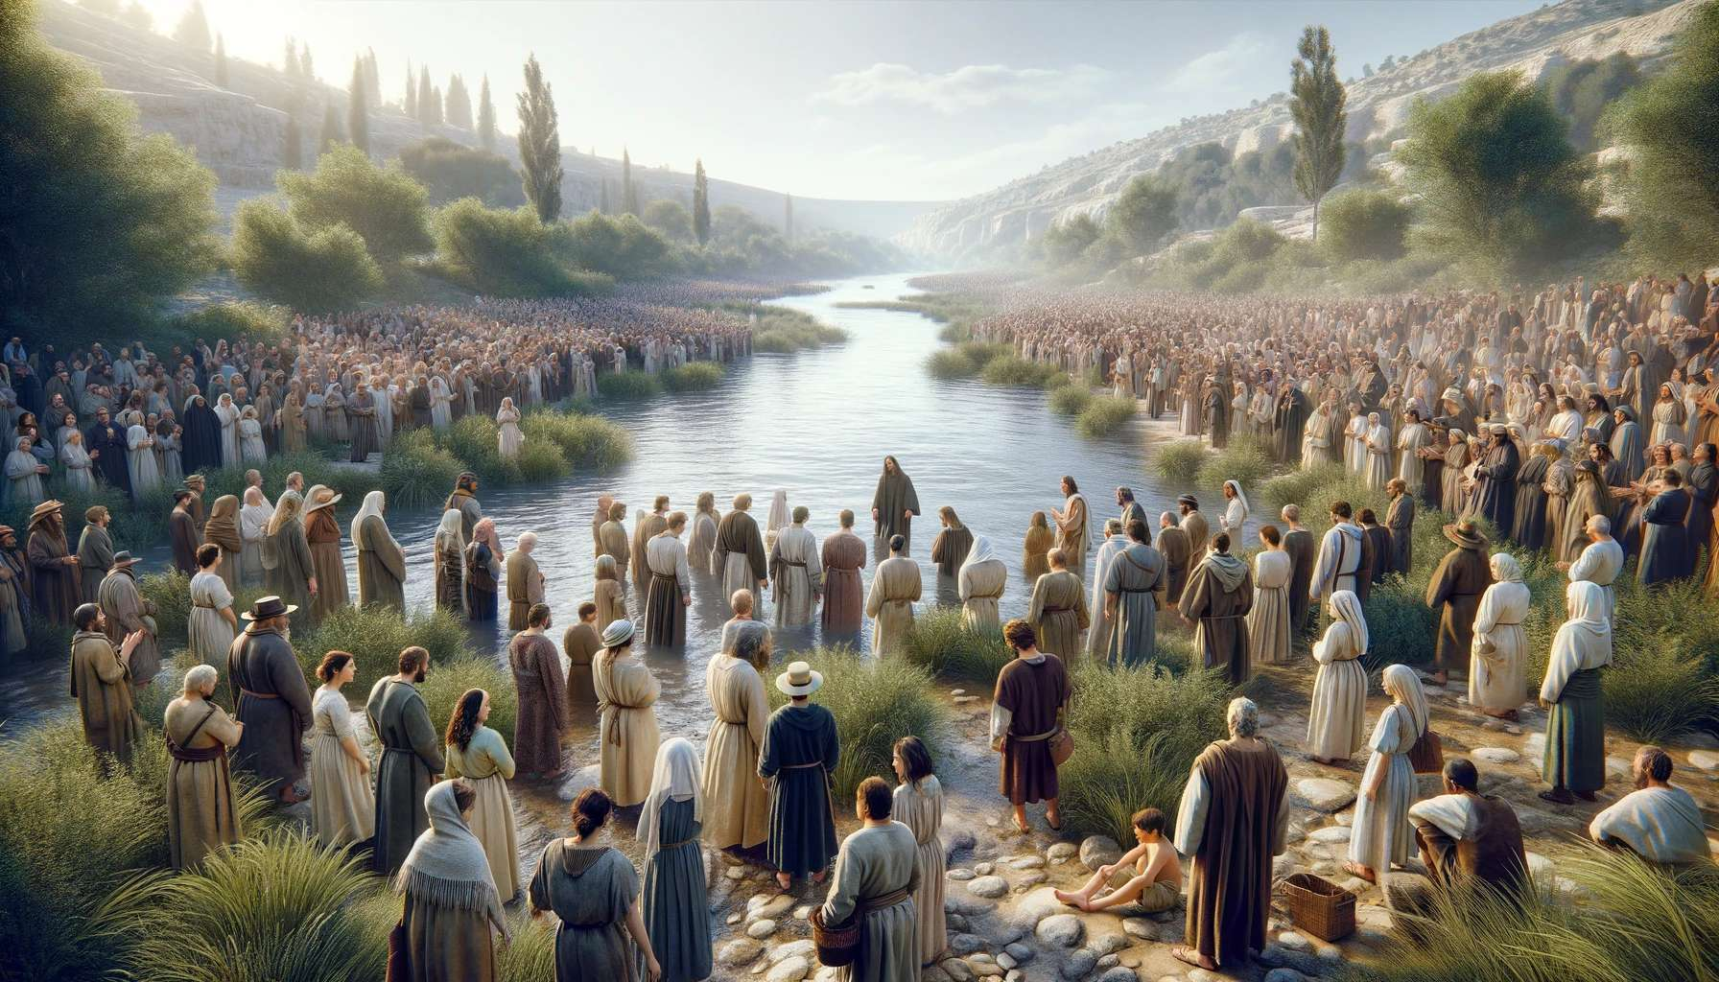

Slide 5
ALL preparation was genius and complete. Many
thousands believed and more continuously were baptized, and this movement was enormous. Flavius Josephus called them Essenes and reported they have members in every city. They called themselves “the way” or “Children of Light” They were visited by the Angel of GOD about 186 BC and they also called themselves the “Sons of Zadok”. Who was the Priest in the Time of King David and was promoted 1st High Priest of the 1st Temple of Solomon.

Slide 7

Ephesus
Smyrna
Pergamos
Thyatira
Sardis
Philadelphia
Laodicea
Roman Catholic Church
Apostolic Fathers
Church Fathers
Reformed Church
Loose Churches
Early Church Fathers
Free Churches
30
2030

Slide 8
History is never smooth
The devils are there to disturb right from the beginning and it continues all
the way of THE WAY

Slide 9
Excurse Simon Magus the Sorcerer
Mentioned in Acts 8. considered the founder of Gnosticism by early Church Fathers.
Tried to buy the power of the Holy Spirit (hence the term simony).
Act 8:23 For I perceive that you are for gall of bitterness Deu 29:16-18 and bond of Iniquity.
meaning you are and devilish idolater
He be became a major influencer of the Roman emperors since Claudius over Nero up to Galba. His reign marked the beginning of a tumultuous period known as "the year of the four emperors," during which several individuals briefly claimed the title of emperor before Vespasian established stability.
He taught Christianity for the ordinary People and Mysteries for Rulers

Slide 10
Excurse Elymas the Sorcerer
a certain sorcerer, a false prophet, a Jew, whose name was Barjesus: ⁷ Which was with the deputy of the country, Sergius Paulus, a prudent man; who called for Barnabas and Saul, and desired to hear the word of God. ⁸ But Elymas the sorcerer (for so is his name by interpretation) withstood them Acts 13:6-8
The outcome of this Heresy was:
that through all time in European Royalty they claimed to be descendants of Jesus and therefore rightful rulers.

Slide 11
Excurse Hymenaeus and Philetus
Ὑμέναιος = god of marriage
Φίλητος = tied to love
Mentioned in 2 Timothy 2:17–18.
Taught that the resurrection had already occurred, which was considered heretical.

Slide 12
Alexander the Coppersmith
Mentioned in 2 Timothy 4:14 and possibly in 1 Timothy 1:20.
Opposed Paul's teachings and was "handed over to Satan" for correction.

Slide 13
Excurse Nicolaitans Νικολαΐτης
Mentioned in Revelation 2:6, 15.
νίκη + λαός = "conquerors of the people“ = spiritual or hierarchical domination
Their teachings were condemned by Jesus in the letters to the churches.
Early Church Fathers (like Irenaeus and Hippolytus) associated them with antinomianism—the belief that moral law is not necessary for Christians—and possibly with idolatry and sexual immorality and pagan practices

Slide 14
Excurse Judaizers
Prominent in Galatians and Acts 15.
Insisted that Gentile Christians must follow Jewish laws, especially circumcision.
Paul strongly opposed their teachings.

Slide 15
Excurse Docetists
Though not named directly in the New Testament, their beliefs are countered in 1 John.
Claimed Jesus only seemed to have a physical body, denying the incarnation.

Slide 16

Apostolic Fathers
32 - 64 AD ΕΦΕΣΟΣ

Slide 17
The first time of Christians in the Bible began The LORD Jesus Himself. These were witnesses that saw heard and experienced at least some of HIS overwhelming ministry.
See some examples now
ΕΦΕΣΟΣ

Slide 18
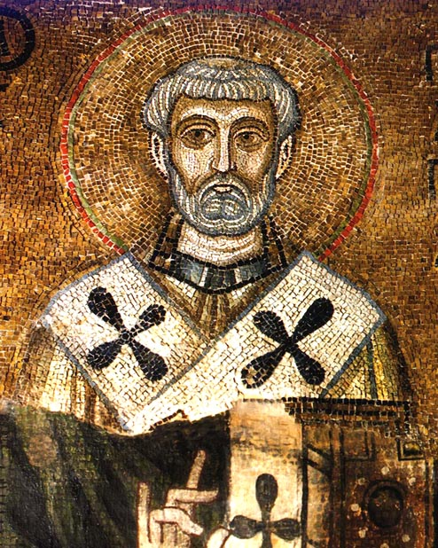
Clement of Rome
ΕΦΕΣΟΣ
Clement was a Bishop of Rome at the end of the first century he is considered the first of the Apostolic Fathers. Tradition holds that he was ordained by Saint Peter himself and was a contemporary of the apostles.
This Photo by Unknown Author is licensed under CC BY-SA

Slide 19

Letter to the Corinthians:
ΕΦΕΣΟΣ
Clement of Rome’s most famous work is his letter to the church in Corinth, written to resolve a dispute about church leadership. He emphasized unity, humility, and the importance of apostolic succession. His analogy compared the church to a human body, where every part is necessary.
This Photo by Unknown Author is licensed under CC BY-NC

Slide 20
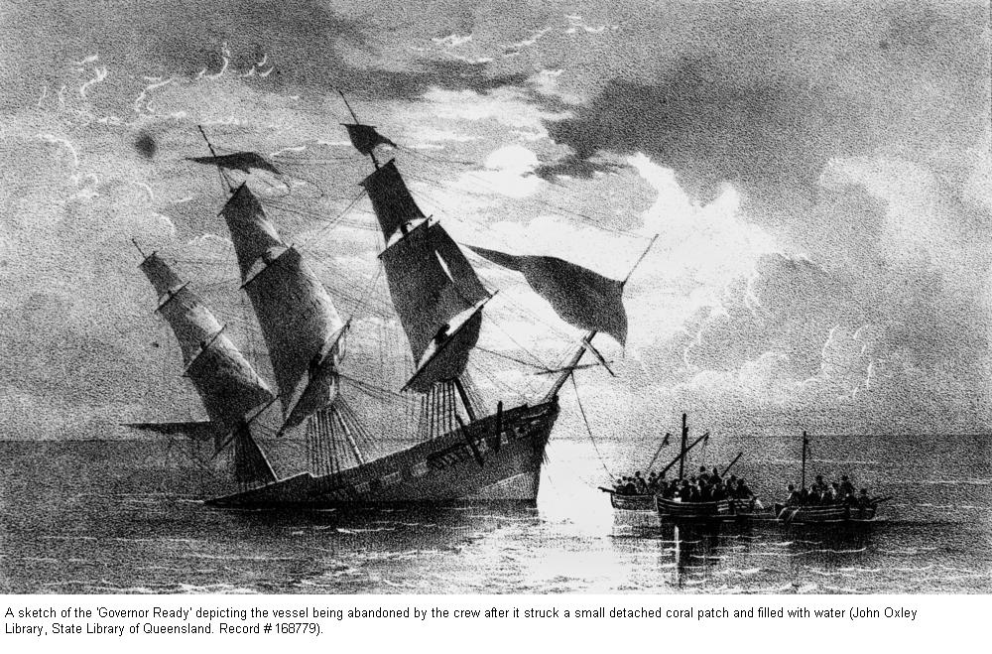
Patron Saint: Due to his manner of death, Clement of Rome is the patron saint of mariners.
ΕΦΕΣΟΣ
Martyrdom: According to tradition, Clement was exiled under Emperor Trajan and martyred by being tied to an anchor and thrown into the sea. Before his death, he is said to have miraculously provided water to fellow prisoners by striking the ground and causing a spring to flow.

Slide 21
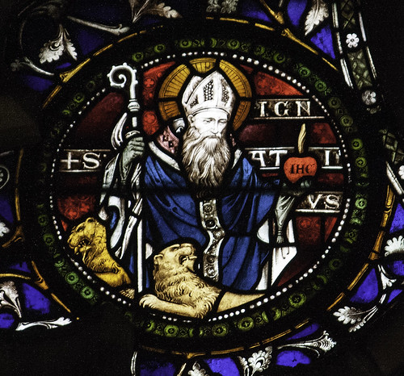
Ignatius of Antioch
ΕΦΕΣΟΣ
Ignatius was the Bishop of Antioch and a disciple of the Apostle John. He is known for his seven letters written on his way to Rome, where he was to be martyred.
Notes:
This Photo by Unknown Author is licensed under CC BY-NC-ND

Slide 22
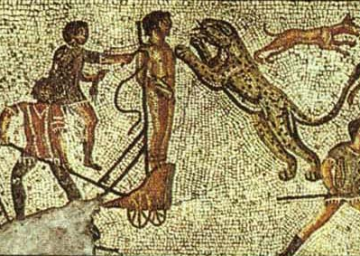
Journey to Martyrdom: Ignatius was arrested and taken to Rome under guard, writing letters to various churches along the way. He famously begged the Christians in Rome not to interfere with his execution, saying, “Let me be food for the wild beasts, for they are my way to God. I am God’s wheat and bread.”
ΕΦΕΣΟΣ
Notes:
This Photo by Unknown Author is licensed under CC BY-SA

Slide 23
Coined ‘Catholic Church’: Ignatius is the first known Christian writer to use the term “Catholic Church” to describe the universal Christian community.
ΕΦΕΣΟΣ
Quotes:
“It is better to be silent and be real than to talk and not be real.” “Christianity is greatest when it is hated by the world.”

Slide 24
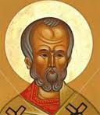
Papias of Hierapolis 60–130 AD
ΕΦΕΣΟΣ
Papias was Bishop of Hierapolis in Asia Minor and a companion of Polycarp. He wrote a five-volume work called “Exposition of the Sayings of the Lord,” which is now lost except for fragments.
Notes:
This Photo by Unknown Author is licensed under CC BY

Slide 25

Collector of Oral Tradition: Papias valued oral tradition over written texts, seeking out those who had heard the apostles directly. He said,
“I did not think that what was to be gotten from books would profit me as much as what came from the living and abiding voice.”
ΕΦΕΣΟΣ
Gospel Origins: Papias reported that Mark wrote his Gospel based on Peter’s preaching, and that Matthew compiled the sayings of Jesus in Hebrew.
Anecdote: Papias was known for his millenarian beliefs, expecting a literal thousand-year reign of Christ on earth.

Slide 26
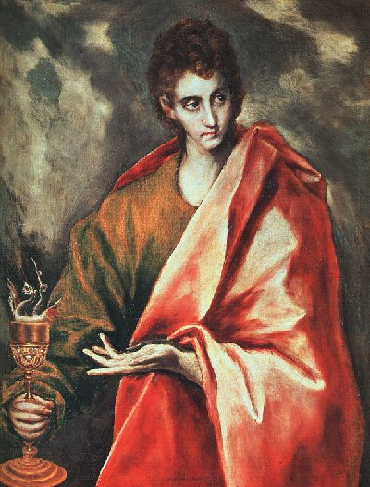
Cerinthus 50-100 AD
ΕΦΕΣΟΣ
Cerinthus was a Jew from Egypt and a contemporary of the apostles, known as a heretical teacher, rather than an Apostolic Father. He taught a form of early Gnosticism, claiming that Jesus was a mere man and that the Christ spirit descended upon him at baptism and left before the crucifixion.
Notes:
This Photo by Unknown Author is licensed under CC BY-SA

Slide 27
John and Cerinthus: The most famous anecdote involves the Apostle John. According to Irenaeus, John once entered a bathhouse in Ephesus, saw Cerinthus inside, and fled, exclaiming, “Let us flee, lest even the bath-house fall down, because Cerinthus, the enemy of the truth, is within!”
ΕΦΕΣΟΣ
Opposition: Cerinthus’s teachings were so controversial that John is said to have written his Gospel specifically to refute Cerinthus’s errors.

Slide 29
Early church Fathers 64 – 313 AD ΖΜΥΡΝΑ

Slide 30
The first persecution of Christians in the Bible began in 64 AD during the reign of Nero, who blamed the Christians for the Great Fire of Rome. This led to widespread persecution, with many Christians executed for their beliefs, including the execution of Peter and Paul. The persecution continued under subsequent Roman emperors, including Domitian and Trajan, until it was officially ended in 313 AD with the Edict of Milan, which granted religious freedom to Christians.
ΖΜΥΡΝΑ

Slide 31
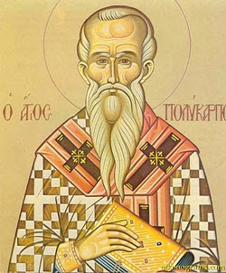
Polycarp of Smyrna 69 to 155 AD.
Polycarp was Bishop of Smyrna, a disciple of John the Apostle, and a mentor to Irenaeus.
ΖΜΥΡΝΑ
Notes:
This Photo by Unknown Author is licensed under CC BY-NC-ND

Slide 32
Martyrdom: At age 86, Polycarp was arrested and brought before the Roman authorities. When asked to renounce Christ, he replied, “Eighty and six years have I served Him, and He has done me no wrong. How can I blaspheme my King who saved me?” He was burned at the stake, but when the flames did not consume him, he was stabbed.
Confrontation with Heresy:
Polycarp famously confronted the heretic Marcion, calling him “the firstborn of Satan”.
Anecdote:
Polycarp’s humility and gentleness were legendary. He was known for quoting scripture over 90 times in his short letter to the Philippians.
ΖΜΥΡΝΑ

Slide 33
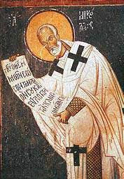
Origenus, born A.D. 134 or 135
gives much information as to the Mysteries of the Ophites; and there is no doubt that all the Gnostic sects had Mysteries and initiation. They all claimed to possess a secret doctrine, coming to them directly from Jesus Christ, different from that of the Gospels and Epistles, and Superior to those communications, which in their eyes, were merely exoteric.
ΖΜΥΡΝΑ
Notes:
This Photo by Unknown Author is licensed under CC BY-NC-ND

Slide 34
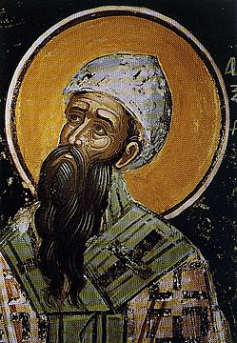
Clemens Bishop of Alexandria, A.D.191
says in his “Stromata”, that he cannot explain the Mysteries, because he should thereby, according to the old proverb, put a sword into the hands of a child.
ΖΜΥΡΝΑ
This Photo by Unknown Author is licensed under CC BY-SA
Notes:
This Photo by Unknown Author is licensed under CC BY-NC-ND

Slide 35
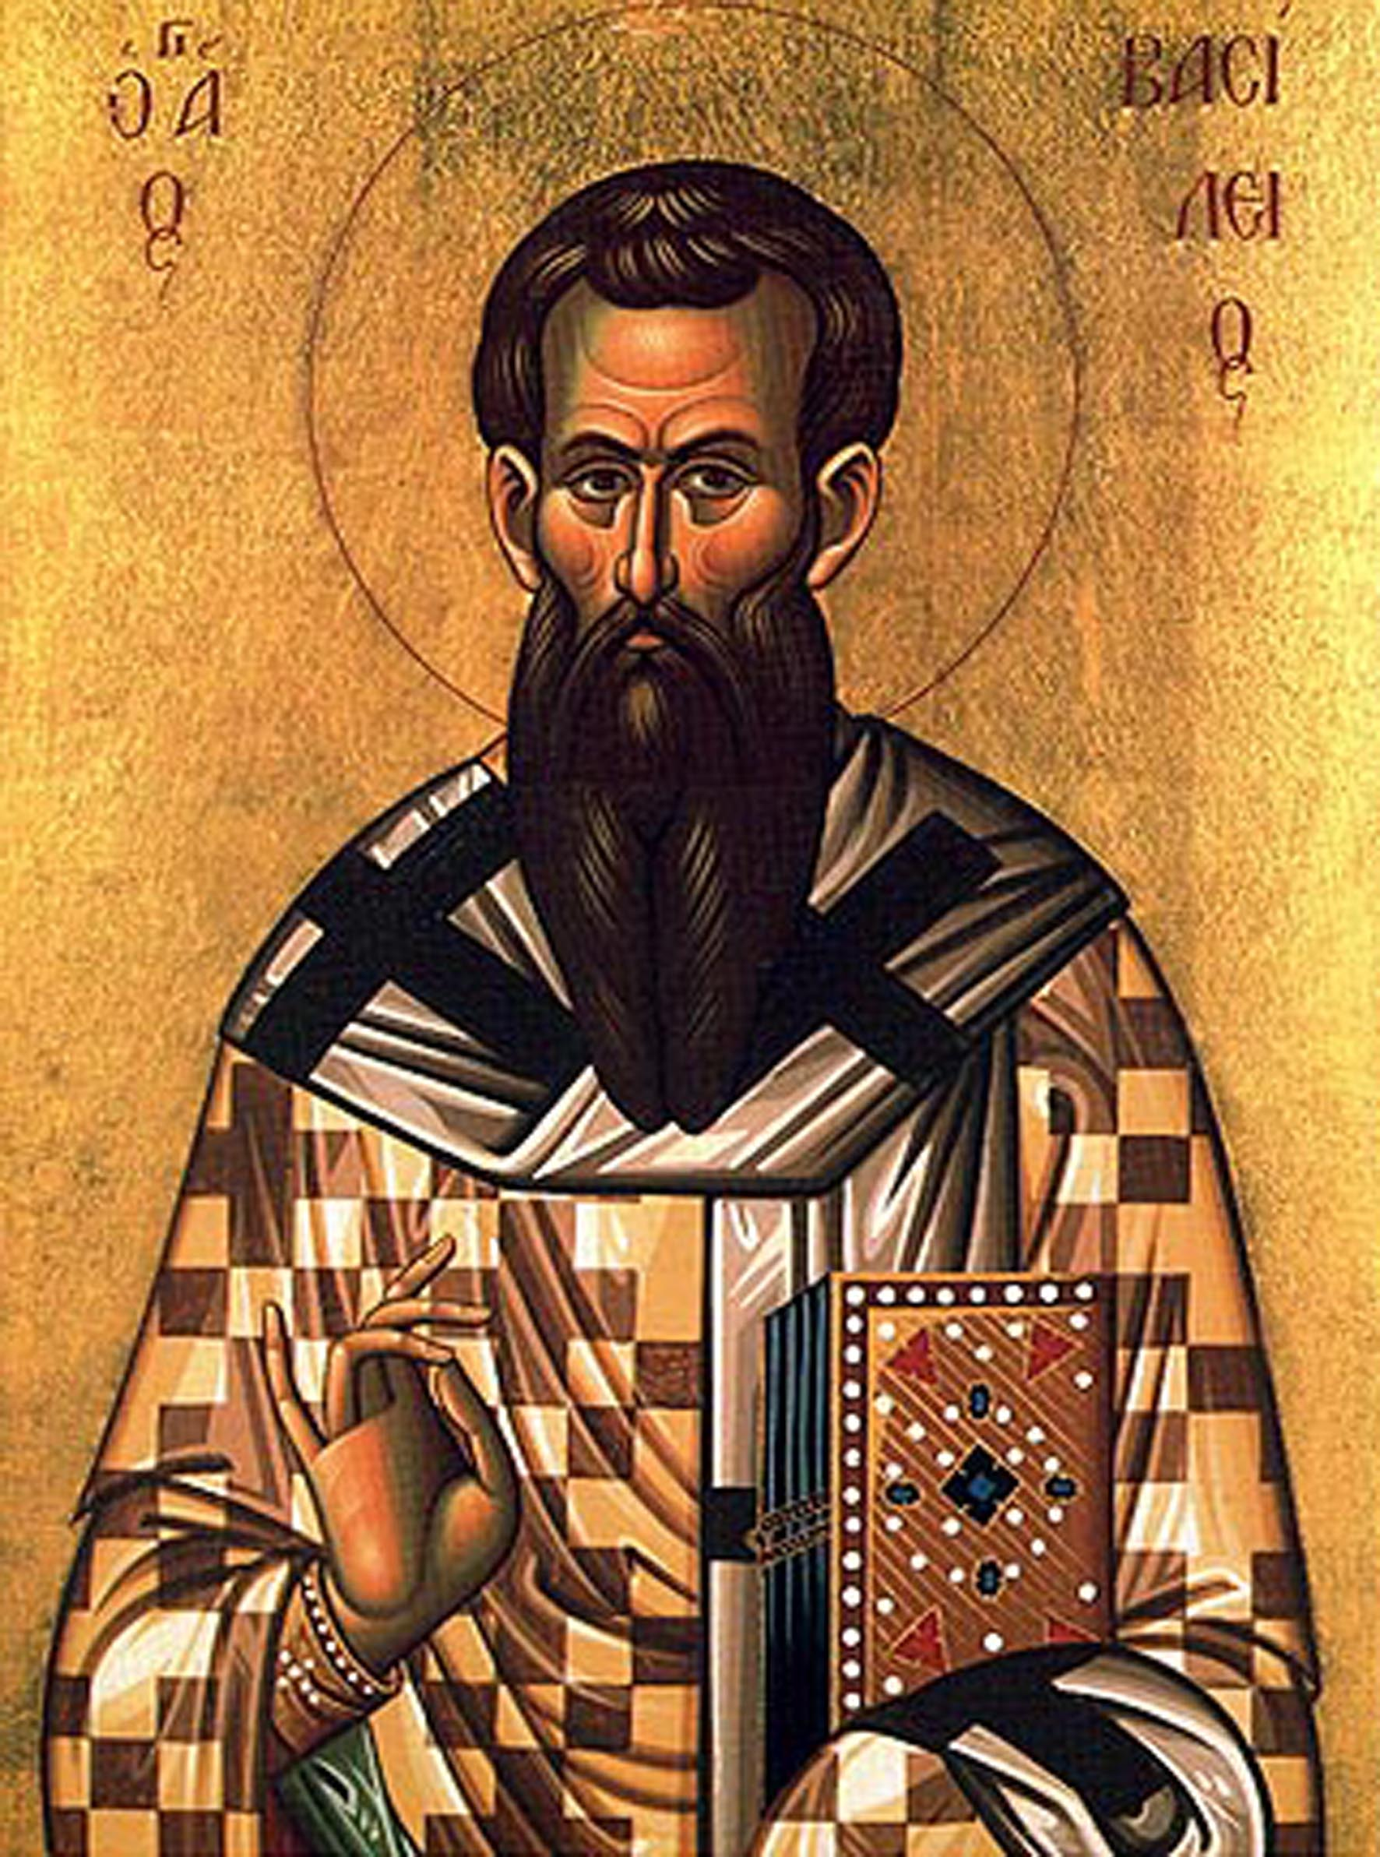

Tertullian 216 AD
says in his “Apology”:
«None are admitted without
an oath of secrecy. We ap-
peal to our Thracian and Eleusinian Mysteries: and
we are especially bound to
this caution, because if we
prove faithless, we should
not only provoke Heaven but draw upon our heads the utmost rigor of human displeasure. And should strangers betray us? They know nothing but by report and hearsay. Far hence, ye Profane! Is the prohibition from all holy Mysteries.»
ΖΜΥΡΝΑ
This Photo by Unknown Author is licensed under CC BY-ND
Notes:
This Photo by Unknown Author is licensed under CC BY-NC-ND

Slide 36
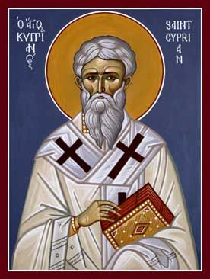
Thascius Caecilius Cyprianus of Carthage 200-258 AD
Berber and successful lawyer and rhetoric teacher. Converted in 246 he gave much of his wealth to the poor. Ordained a priest and then elected Bishop of Carthage about 248 AD
Major Events: Led the church during the Decian (250 AD) and Valerian (257–258 AD) persecutions. He was hiding but writing letters
Advocated for repentance and penance for Christians who lapsed under persecution, taking a moderate stance between strict and lenient factions. [britannica.com]
Writings: Authored influential theological works, including “On the Unity of the Church”, letters, and treatises on church discipline and charity.
Martyrdom: Arrested in 258 AD for refusing to sacrifice to Roman gods; Was beheaded on September 14, 258 AD, in Carthage
ΖΜΥΡΝΑ
Notes:
This Photo by Unknown Author is licensed under CC BY-NC-ND

Slide 37
Church Fathers 313 -538 AD ΠΕΡΓΑΜΟΣ

Slide 38
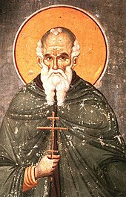
Athanasius of Alexandria (c. 296–373)
Legacy: Defender of Trinitarian doctrine against Arianism. His persistence led to the eventual triumph of Nicene orthodoxy.
Anecdotes: Athanasius was exiled five times due to his opposition to Arianism. Despite imperial pressure, he famously declared, “Athanasius contra mundum” (“Athanasius against the world”), showing his unwavering commitment to the truth.
ΠΕΡΓΑΜΟΣ
Notes:
This Photo by Unknown Author is licensed under CC BY-SA

Slide 39
Excurse Arianism
is a Christian theological belief originating with Arius, a 4th-century priest. It teaches that Jesus Christ, the Son of God, is not co-eternal or equal with God the Father, but was created by Him. Arianism denies the Trinity, asserting that only God the Father is truly divine. This view sparked major controversy in early Christianity, leading to its condemnation at the Council of Nicaea in 325 AD. Despite this, Arianism influenced various groups for centuries and played a significant role in shaping early church debates about Christ’s nature and the doctrine of the Trinity.

Slide 40
Excurse Montanism
Montanism was a 2nd-century Christian movement founded by Montanus. It emphasized prophecy, spiritual gifts, and the imminent return of Christ. Followers believed the Holy Spirit spoke directly through prophets, including Montanus and two women. The movement promoted strict moral standards and challenged church authority, eventually being declared heretical.

Slide 41
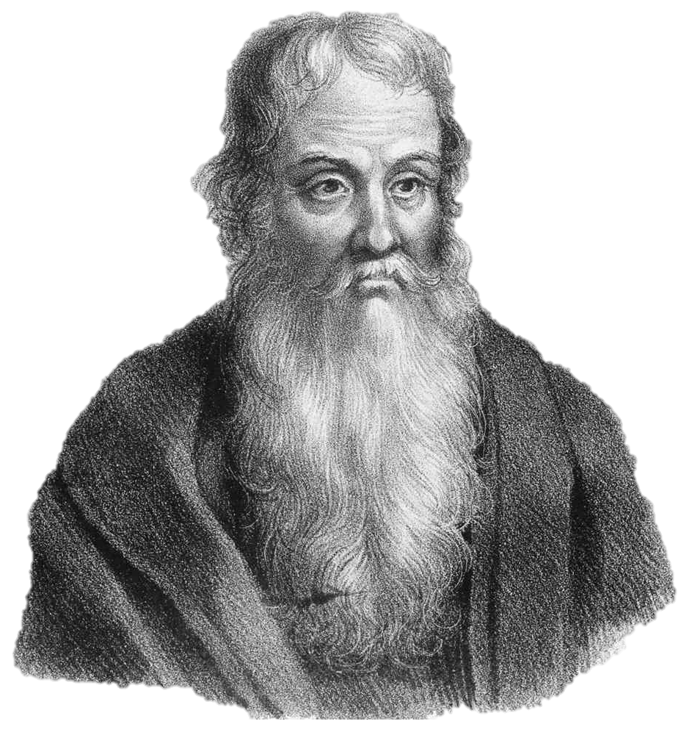
Eusebius of Caesarea (c. 260–340)
Legacy: Known as the “Father of Church History,” Eusebius wrote the first comprehensive history of the Christian Church, documenting its development from the apostles to his own time.
Anecdotes: Eusebius was a close associate of Constantine and wrote his biography. He attended the Council of Nicaea and played a key role in shaping the early church’s understanding of its own history.
ΠΕΡΓΑΜΟΣ
Notes:
This Photo by Unknown Author is licensed under CC BY-SA

Slide 42
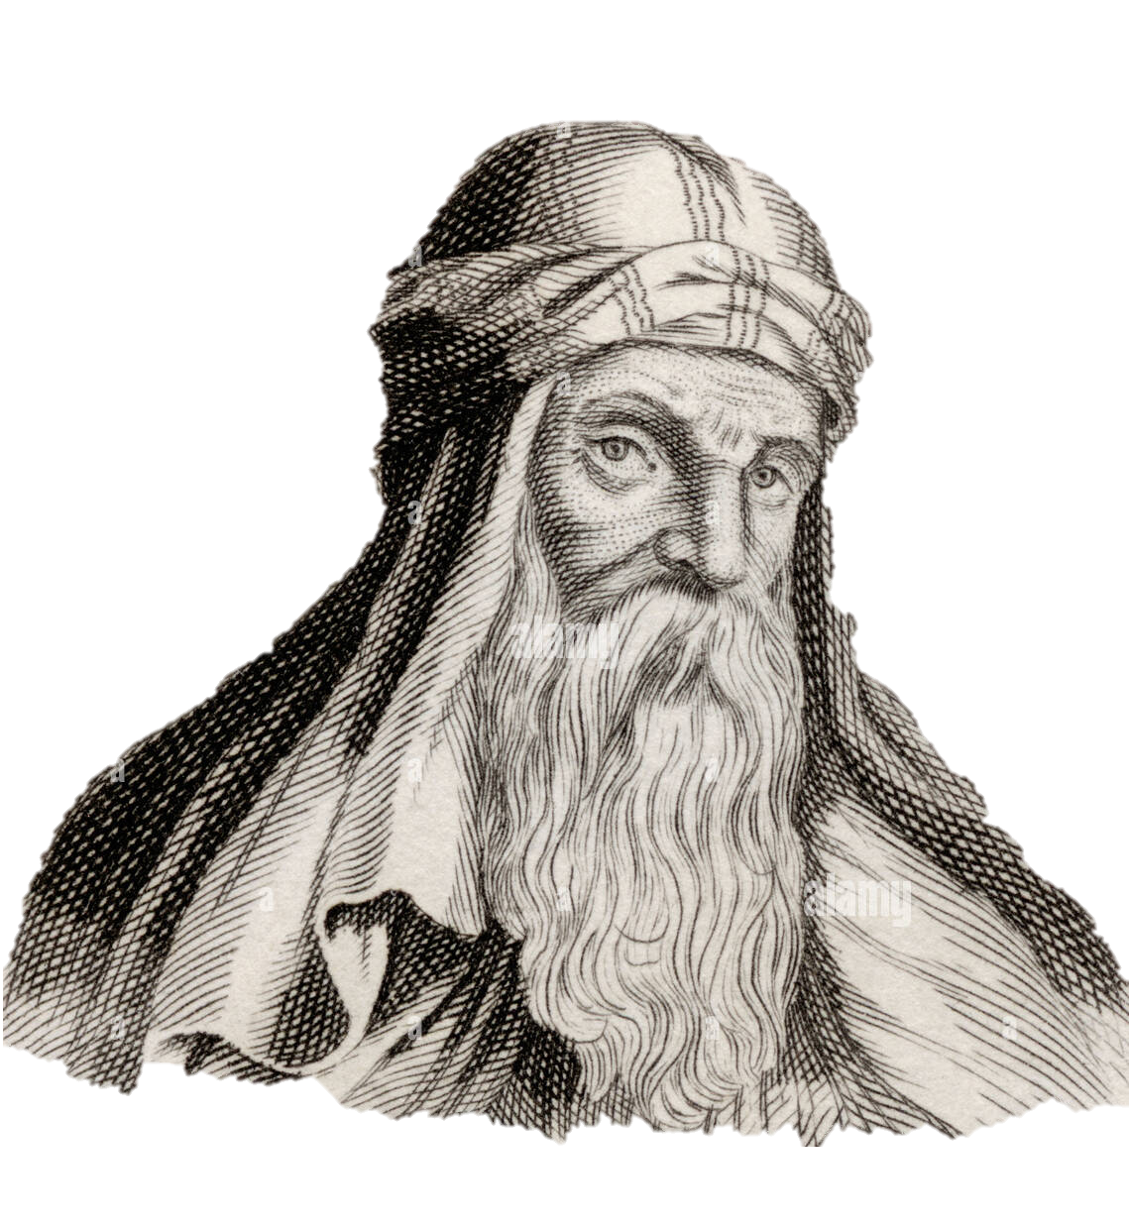
Basil the Great (c. 330–379)
Legacy: One of the Cappadocian Fathers, Basil was instrumental in developing monasticism and defending the doctrine of the Trinity.
Anecdotes: Basil’s generosity was legendary; during a famine, he organized soup kitchens and distributed food to the poor. He also founded hospitals, setting a precedent for Christian charity.
ΠΕΡΓΑΜΟΣ
Notes:
This Photo by Unknown Author is licensed under CC BY-SA

Slide 43
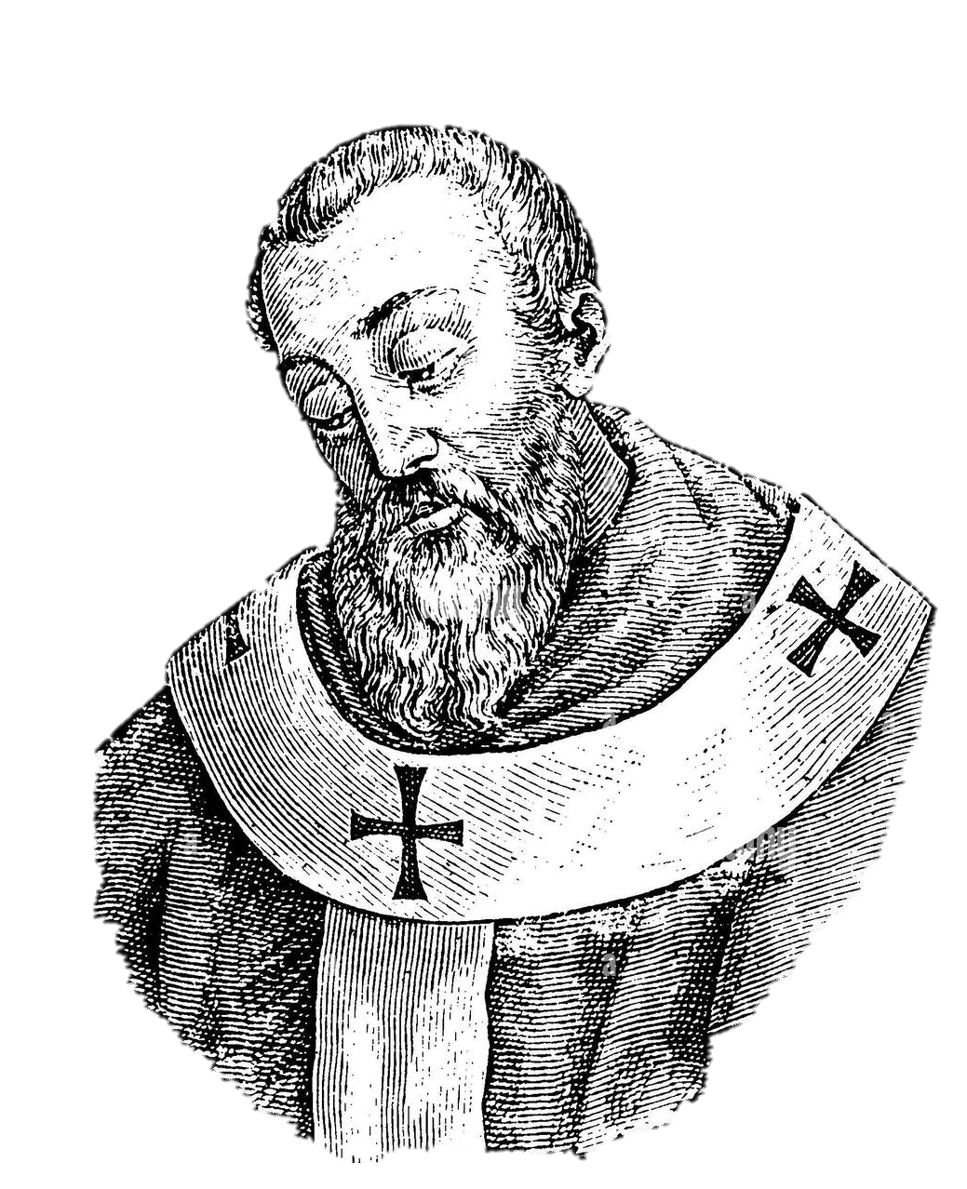
Gregory of Nazianzus (329–389)
Legacy: Renowned theologian and orator, Gregory helped clarify the doctrine of the Trinity and contributed to the Nicene Creed.
Anecdotes: Gregory reluctantly became Bishop of Constantinople and faced fierce opposition. His humility and eloquence earned him the title “The Theologian”.
ΠΕΡΓΑΜΟΣ
Notes:
This Photo by Unknown Author is licensed under CC BY-SA

Slide 44
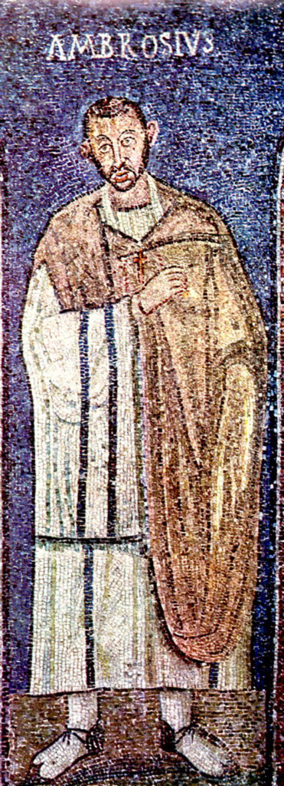
Aurelius Ambrosius (St. Ambrose) (339-397)
Role: Bishop of Milan Italy (from 374 to 397 AD)
Born in Trier into a noble Roman Christian family; his father was the prefect of Gaul. Raised in Rome after his father's death.
Career: Originally a Roman governor of Liguria and Emilia. Unexpectedly chosen as Bishop of Milan while still a catechumenus (not yet baptized); he was baptized and consecrated bishop within eight days.
Contributions: Defended orthodox Christianity against Arianism. Influenced church-state relations, famously stating, “The emperor is in the Church, not above the Church.” Reformed church liturgy and promoted sacred music (Ambrosian chant).
Mentor to St. Augustine, whom he baptized.
Known for his eloquent sermons and theological writings.
Legacy: Recognized as one of the four original Doctors of the Church. Patron of Milan and beekeepers. Feast day: Dec. 7. Died: April 4, 397 AD
ΠΕΡΓΑΜΟΣ
Notes:
This Photo by Unknown Author is licensed under CC BY-SA

Slide 45
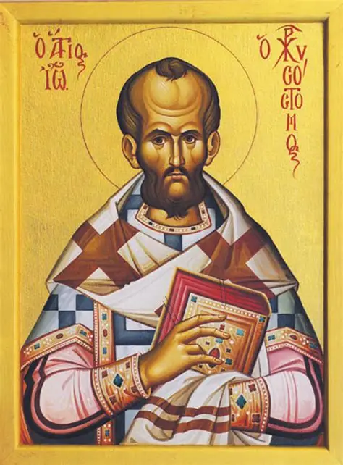
John Chrysostom (c. 347–407)
Legacy: Famous for his powerful sermons (“golden-mouthed”), he reformed church practices and advocated for the poor.
Anecdotes: As Bishop of Constantinople, John’s criticism of the wealthy and the imperial family led to his exile. His sermons are still read today for their spiritual depth and social critique.
ΠΕΡΓΑΜΟΣ
Notes:
This Photo by Unknown Author is licensed under CC BY-SA

Slide 46
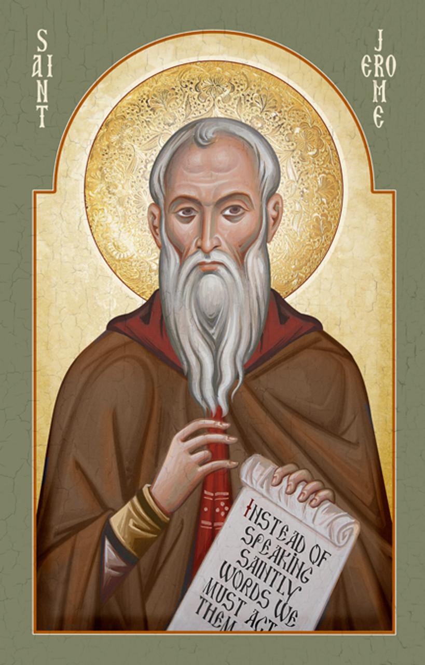
Jerome (c. 342–420)
Legacy: Translated the Bible into Latin (the Vulgate), a later Latin translation which became the standard for Western Christianity and was declared only “authentic” at the Council of Trent (1545–1563). Specifically, in Session IV (April 8, 1546), and was ever since treated as infallible.
Anecdotes: Jerome lived as a hermit in Bethlehem, where he devoted himself to scholarship. He was known for his sharp wit and fierce debates with other theologians.
ΠΕΡΓΑΜΟΣ
Notes:
This Photo by Unknown Author is licensed under CC BY-SA

Slide 47
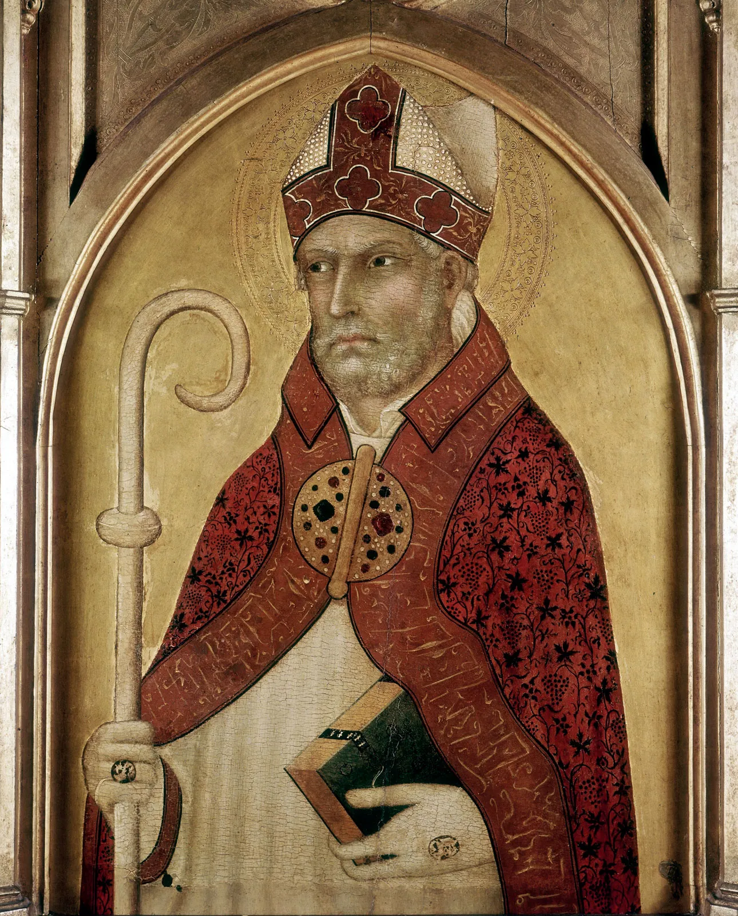
Augustine of Hippo (354–430)
Legacy: One of the most influential theologians in Christian history. His works, especially “Confessions” and “The City of God,” shaped Western thought.
Anecdotes: Augustine’s dramatic conversion from a life of pleasure to Christian faith is recounted in his “Confessions.” He became Bishop of Hippo and defended the church against various heresies. Nevertheless, he was initiated in a secret Esoteric cult and believed in reincarnation. He was in his discourse talking about sublime Mysteries sometimes. He divorced his 1st wife because she had no Roman citizenship. His mother Monica was arranging for a young girl of 10 years that he liked which was much too young to marry for a 30-year-old man like him so, he needed to wait and got a concubine in between. He was doing the Romans all favors they asked for. He was rewriting the 10 commandments to legalize the status and carved images and wrote about the separation of state and religion to take the power away from the church. It is Strange that such a man was declared holy having no miracles.
ΠΕΡΓΑΜΟΣ
AUGUSTINUS
Notes:
This Photo by Unknown Author is licensed under CC BY-SA

Slide 48
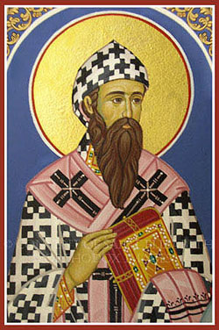
Cyril of Alexandria
Born: Around 375–378 AD, Egypt
Died: June 27, 444 AD, Alexandria, Egypt
Role: Patriarch (Bishop) of Alexandria from 412 to 444
Major Achievements:
Led the Church of Alexandria into intense theological and political struggles(c. 375–444)
Presided over the Council of Ephesus in 431, which condemned Nestorianism who preferred the title “Mother of Christ,” emphasizing that Mary gave birth to Jesus as a man, and affirmed the unity of Christ’s divine and human natures.
Legacy:
Cyril’s battling teachings shaped Catholic doctrine, especially concerning Christology and the worship of Mary. His tenure was marked by controversy, including conflicts with Jews, pagans, and rival Christian groups in Alexandria.
Venerated as a saint in Catholic, Orthodox, Anglican, and Lutheran traditions; feast day is June 27 (Western churches) and June 9 (Eastern churches).
ΠΕΡΓΑΜΟΣ
Cyril of Alexandria
This Photo by Unknown Author is licensed under CC BY-NC-ND

Slide 49
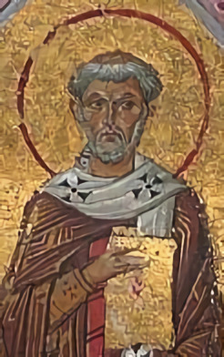
Leo the Great (Pope Leo I)
( c. 400–461)
Legacy: Asserted the authority of the papacy and clarified Christological doctrine at the Council of Chalcedon (451).
Anecdotes: Leo famously persuaded Attila the Hun to turn back from invading Rome, earning him legendary status as a protector of the city.
Notes:
This Photo by Unknown Author is licensed under CC BY-SA

Slide 50
Roman catholic church
538 – 1798 AD ΘΥΑΤΕΙΡΑ

Slide 51
Roman Catholicism is not knowing the word of GOD good enough and as a result picking up mistakes through the time and insisting on them. Believers in this church turned to mysticism and sexual abstention to avoid clashes with their leadership. Many who loved Gods word were brutally murdered and labeled as witches. The inquisition against Jews and real Christians in her time and intensifying with Ignatius de Loyola remains a part of her brutal legacy.
In later times when this church faced protest her answer was war and counterreformation. It was not about faith but of power and rulership and ownership of earthly goods. Church members had not been of importance they were more a kind of milk cow to be exploited. During the long period of her reign, she never repented from her bloodthirsty habits. Up to nowadays priests need to go into the houses of widows and get the inheritance to be a treasure for the church. The countless doctrinal wrongdoings have always been defended even the indulgence letters that were established to found the St. Peters cathedral.
ΘΥΑΤΕΙΡΑ

Slide 52
Pope Gregory I
(Gregory the Great, 540–604)
ΘΥΑΤΕΙΡΑ
Legacy: Reformed church administration, promoted missionary work (especially to England), and wrote influential theological works.
Anecdotes: Gregory’s humility was evident in his title “Servant of the Servants of God.” He sent Augustine of Canterbury to evangelize the Anglo-Saxons and is credited with Gregorian chant.

Slide 53
Saint Isidore of Seville (c. 560–636)
ΘΥΑΤΕΙΡΑ
Legacy: Compiled the first encyclopedia of the Middle Ages, the Etymologiae, and worked to unify the Visigothic kingdom under Christianity.
Anecdotes: Isidore was known for his scholarship and is considered the last of the ancient Christian philosophers

Slide 54
Saint Bede the Venerable (c. 672–735)
ΘΥΑΤΕΙΡΑ
Legacy: His Ecclesiastical History of the English People is a foundational text for English history and church history.
Anecdotes: Bede was renowned for his learning and piety, and was declared a Doctor of the Church.

Slide 55
Saint Anselm of Canterbury (1033–1109)
ΘΥΑΤΕΙΡΑ
Legacy: Developed the “ontological argument” for the existence of God and contributed to medieval scholasticism.
Anecdotes: Anselm’s writings and leadership helped shape the intellectual life of the church.

Slide 56
Saint Bernard of Clairvaux (1090–1153)
ΘΥΑΤΕΙΡΑ
Legacy: Influential in the Cistercian reform, preached the Second Crusade, and wrote mystical theology.
Anecdotes: Bernard’s eloquence and spiritual depth made him a key figure in medieval Christianity.

Slide 57
Saint Thomas Aquinas (1225–1274)
ΘΥΑΤΕΙΡΑ
Legacy: His Summa Theologica is one of the most important works of Christian theology, synthesizing faith and reason.
Anecdotes: Aquinas was called the “Angelic Doctor” and his teachings remain central in Catholic philosophy.

Slide 58
Saint Francis of Assisi (1181/2–1226)
ΘΥΑΤΕΙΡΑ
Legacy: Founded the Franciscan Order, emphasizing poverty, humility, and care for creation.
Anecdotes: Known for his love of animals and nature, Francis is said to have preached to birds and tamed a wolf.

Slide 59
Saint Catherine of Siena (1347–1380)
ΘΥΑΤΕΙΡΑ
Legacy: Mystic, theologian, and influential in church politics, especially during the Avignon Papacy.
Anecdotes: Catherine’s letters and visions inspired many, and she persuaded the Pope to return to Rome.

Slide 60
Saint Teresa of Ávila (1515–1582)
ΘΥΑΤΕΙΡΑ
Legacy: Reformed the Carmelite Order and wrote spiritual classics like The Interior Castle.
Anecdotes: Teresa’s mystical experiences and practical reforms made her a Doctor of the Church.

Slide 61
Saint Ignatius of Loyola (1491–1556)
ΘΥΑΤΕΙΡΑ
Legacy: Founded the Jesuit Order (also compare with the Jesuit oath), which became a major force and army of the papacy in war against Jew, believers and reformers even to bring down governments like in South Africa. He worked in education and missionary work totally dedicated to the roman church rather than Jesus. What was beneficial for the Roman church was good for him even the persecution of Christians that he understood to be heretics.
Anecdotes: Ignatius’s spiritual exercises and leadership shaped Catholic divine downfall by the Counter-Reformation.

Slide 62
Saint Alphonsus Liguori (1696–1787)
ΘΥΑΤΕΙΡΑ
Legacy: Founded the Redemptorists, wrote extensively on moral theology, and was declared a Doctor of the Church. The Redemptorists spirituality has nowadays major flaw following useless Philosophies and so-called science like that of the Jesuit Pierre Teilhard de Chardin whose teaching shows the distance from them to Jesus.
Anecdotes: Alphonsus was known for his compassion and practical approach to spirituality.

Slide 63
Notable Popes
ΘΥΑΤΕΙΡΑ
Pope Gregory VII (1073–1085): Led reforms to free the church from secular control, promoted clerical celibacy, and excommunicated Emperor Henry IV.
Pope Innocent III (1198–1216): Asserted papal authority, called the Fourth Lateran Council, and influenced medieval politics.
Pope Leo X (1513–1521): Oversaw the beginning of the Protestant Reformation.
Notes:
[franciscanmedia.org]

Slide 64
The reformers
1300 – 1800 AD ΣΑΡΔΙΣ

Slide 65
ΣΑΡΔΙΣ
The reformers laid the foundation for freedom of the church. Often it had not been the wish for them to establish a new church, but the Roman church forced them out banned them and broke with them and so they scattered the church into many pieces.
The reformers just tried to pick them up and glue them together again without the brutal part that destroyed the image of church. Even though their work was not perfect, but it was enormous and effective. And Thanks to GOD they listened to Jesus Word as possible.

Slide 66
Proto-Protestant
ΣΑΡΔΙΣ
In the late 12th century, the valiant Waldensians, born from the fervor of Peter Waldo, a merchant turned man of apostolic poverty, rose as the Poor of Lyon. From the rugged Cottian Alps, they spread their bold creed, seeking spiritual perfection. Defiant against the Catholic Church’s decrees, they clashed with bishops over their right to preach truth freely. Branded heretics by 1215, they faced relentless persecution yet stood resolute. Though some rejoined the Church as “Poor Catholics”, many endured, their spirit unbroken. In the 16th century, guided by Swiss reformer Heinrich Bullinger, these steadfast warriors of faith united with the Protestant cause, their legacy a beacon of courage and conviction. Also here the Roman church was always the reason for murder in persecution.

Slide 67
Early Reformers (Pre-Reformation)
ΣΑΡΔΙΣ
John Wycliffe (c. 1320–1384, England):
Criticized church corruption, translated the Bible into English, and taught that Scripture should be the sole authority. His followers were called “Lollards.” He died after a stroke.
Jan Hus (c. 1369–1415, Bohemia):
Influenced by Wycliffe, Hus called for reform and was burned at the stake for heresy. His movement led to the Hussite Wars in Bohemia.
Girolamo Savonarola (1452–1498, Italy):
Preached against church corruption in Florence and was executed for heresy.

Slide 68
Protestant Reformation (16th Century)
ΣΑΡΔΙΣ
Martin Luther (1483–1546, Germany):
Posted his “95 Theses” in 1517, challenging church practices like the sale of indulgences. This event is considered the start of the Protestant Reformation.
Huldrych Zwingli (1484–1531, Switzerland):
Led reform in Switzerland, opposing church traditions not found in the Bible.
John Calvin French Jehan Cauvin (1509–1564, France/Switzerland):
Developed Calvinism, emphasizing predestination and the authority of Scripture.
John Knox (1514–1572, Scotland):
Led the Reformation in Scotland, founding the Presbyterian Church.

Slide 69
THE 16th Century (1500s)
ΣΑΡΔΙΣ
Lutheran Church (Germany, 1520s):
Founded by Martin Luther, emphasizing justification by faith and the authority of Scripture, “Saved by Grace” and the Son of GOD alone.
The free will of man plays an important rule against Swizz reformers. Martin Luther was an amazing honest and courageous man protected by Frederick the Wise Elector and Duke of Saxony.

Slide 70
THE 16th Century (1500s)
ΣΑΡΔΙΣ
Reformed/Calvinist Churches (Switzerland/France, 1530s):
  Led by Huldrych Zwingli and John Calvin, focusing on God’s sovereignty and predestination.
Anglicans (Church of England) (England, 1534):
  Established by King Henry VIII after breaking from the Catholic Church.
Anabaptists (Europe, 1520s):
  Radical reformers advocating adult baptism; includes Mennonites and Hutterites.
Presbyterianism (Scotland/Europe, 1540s):
  Developed from Calvinist theology, emphasizing church governance by elders.

Slide 71
THE 16th Century (1500s)
ΣΑΡΔΙΣ
Reformed/Calvinist Churches (Switzerland/France, 1530s):
• Led by Huldrych Zwingli and John Calvin, focusing on God’s sovereignty and predestination.
Anglicans (Church of England) (England, 1534):
• Established by King Henry VIII after breaking from the Catholic Church.
Anabaptists (Europe, 1520s):
• Radical reformers advocating adult baptism; includes Mennonites and Hutterites.

Slide 72
🔥 The Huguenots and the St. Bartholomew's Day Massacre
ΣΑΡΔΙΣ
🔥 The Huguenots and the St. Bartholomew's Day Massacre
The Huguenots were French Protestants who followed Calvinist teachings during the 16th century. Their growing influence sparked fierce opposition from Catholic factions, leading to the French Wars of Religion (1562–1598). Tensions peaked on August 24, 1572—St. Bartholomew’s Day—when thousands of Huguenots gathered in Paris for a royal wedding meant to unite Protestants and Catholics. Instead, they were ambushed in a brutal massacre. Over 2,000 were killed in Paris, with thousands more slaughtered across France in the following weeks.
The massacre shattered hopes of religious tolerance. Although the Edict of Nantes (1598) later granted Huguenots limited rights, persecution resumed under Louis XIV. In 1685, the Edict of Nantes was revoked, forcing many Huguenots to flee. Their diaspora enriched Protestant communities across Europe and the Americas, while France suffered a loss of skilled artisans, merchants, and intellectuals.

Slide 73
Timeline Summary
ΣΑΡΔΙΣ
Late 1300s–1400s: Early reformers like Wycliffe and Hus.
1517: Martin Luther’s “95 Theses” marks the official beginning of the Protestant Reformation.
16th Century: Rapid spread of reform movements across Europe, leading to the formation of Protestant churches and major changes in Christianity.
In summary: The first reformers emerged in the late Middle Ages, with Wycliffe and Hus as key figures. The major wave of reform began with Martin Luther in 1517, followed by other leaders across Europe. These reformers challenged church authority, promoted access to the Bible, and laid the groundwork for Protestantism.

Slide 74
Free Churches
1600 – 1900 AD ΦΙΛΑΔΕΛΦΙΑ

Slide 75
Leaving the foundation of the reformers and gaining a further and new freedom from persecution of the roman church protection by Royals and later freed from papacy by Napoleon (=New City) Bonaparte (=Good Part) in the time of the industrial Revolution in in great poverty a people rose up different from all that fixed their Eyes on Jesus learning HIS ways to perfection and doing a great deal in Mission and Social work. They put their lives on stake to reach the impossible “World Mission” This is their part of History
ΦΙΛΑΔΕΛΦΙΑ

Slide 76
17th Century (1600s)
ΦΙΛΑΔΕΛΦΙΑ
Baptists
The Baptist denomination was founded in England and Amsterdam in the Netherlands around 1609. It emphasized believer’s baptism and the autonomy of local congregations.

Slide 77
17th Century (1600s)
ΦΙΛΑΔΕΛΦΙΑ
The Pilgrim Fathers
were a group of English Puritans who sought religious freedom and sailed to North America aboard the Mayflower in 1620. They established the Plymouth Colony in present-day Massachusetts. Their journey and settlement are considered foundational in American history, as they helped lay the groundwork for religious liberty and self-government in the New World. The Pilgrim Fathers are remembered for their perseverance, faith, and the first Thanksgiving celebration with Native Americans.

Slide 78
17th Century (1600s)
ΦΙΛΑΔΕΛΦΙΑ
Quakers (Religious Society of Friends)
Who they were: A Christian movement founded by George Fox in England in the 1650s.
Beliefs: Emphasized the “inner light” (direct experience of God), pacifism, equality, and simplicity.
Settlement: Many Quakers emigrated to America, especially Pennsylvania, which was founded by the Quaker William Penn.
Legacy: Known for social reform, abolitionism, and peaceful activism.

Slide 79
17th Century (1600s)
ΦΙΛΑΔΕΛΦΙΑ
Amish
(Switzerland/France, 1693): Emerged from the Mennonite movement, led by Jacob Amman, emphasizing simplicity and separation from the world.

Slide 80
18th Century (1700s)
ΦΙΛΑΔΕΛΦΙΑ
Methodism
(England, 1739): Founded by John and Charles Wesley as a revival movement within Anglicanism, focusing on personal holiness and social justice.
Brethren Movement
Moravian Church
(Germany/Czech lands Bohemia, renewed in 1722): Emphasized missionary work and community living.

Slide 81
Whereas the Christians of this time were protected by Royal that found faith in Jesus they formed a new Aeon of Mission and social work displaying Christian life to the public
ΦΙΛΑΔΕΛΦΙΑ

Slide 82
17th Century (1600s)
ΦΙΛΑΔΕΛΦΙΑ
August Hermann Francke (1663–1727)
was a German Lutheran pastor, theologian, and educator. He was a key leader in the Pietist movement, which emphasized personal faith and practical Christianity. Francke founded schools with the permission and help of Frederick William I 1688 –1740), known as the Soldier King was King of Prussia. Francke founded an orphanage, and social institutions in Halle, Germany, greatly influencing education and social care. His work inspired later Christian reformers and missionaries, and he is remembered for his faith-based ministry and commitment to helping the poor and underprivileged.

Slide 83
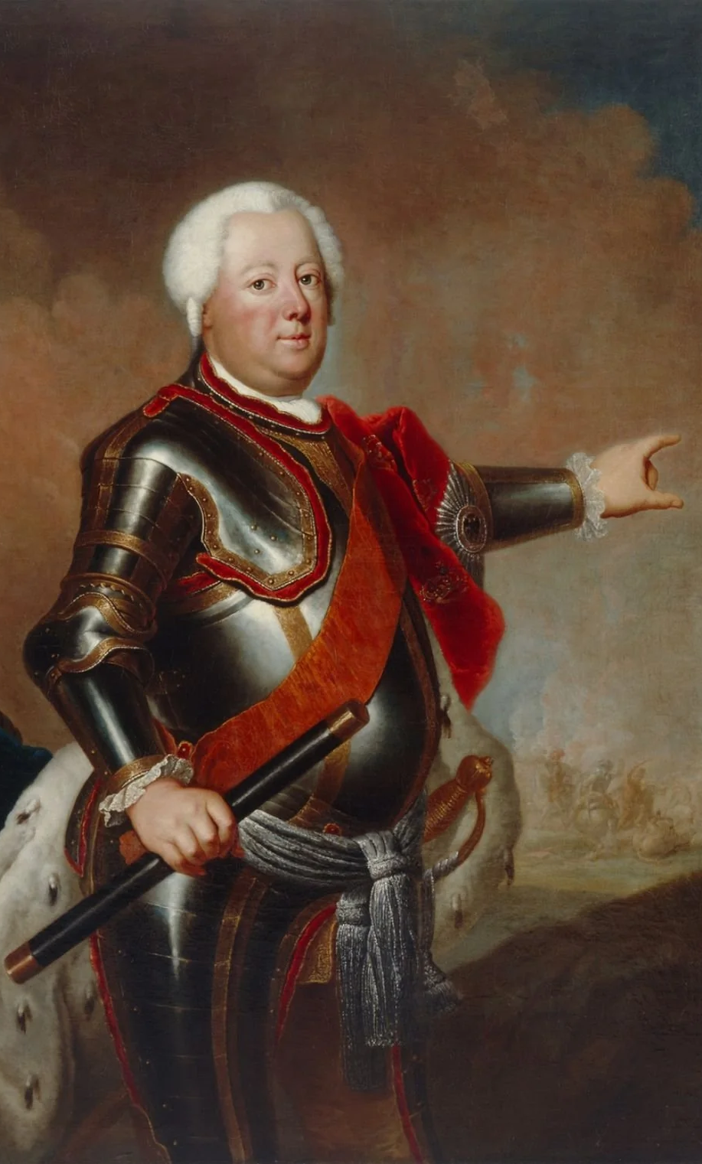
⚔️ Frederick William I
The Soldier King of Prussia
ΦΙΛΑΔΕΛΦΙΑ
1688–1740), known as the "Soldier King," ruled Prussia from 1713 until his death. Born in Berlin, he was raised by the Huguenot governess Marthe de Roucoulle. He transformed the state into a disciplined, militarized power, doubling the army to 80,000 men and introducing the Canton system to streamline conscription. A strict Calvinist, he imposed rigorous standards on public servants and centralized authority, reducing corruption and waste. Though he sold off overseas colonies, he prioritized internal development—reclaiming land, storing grain, and encouraging Protestant immigration, notably the Salzburg exiles.

Slide 84
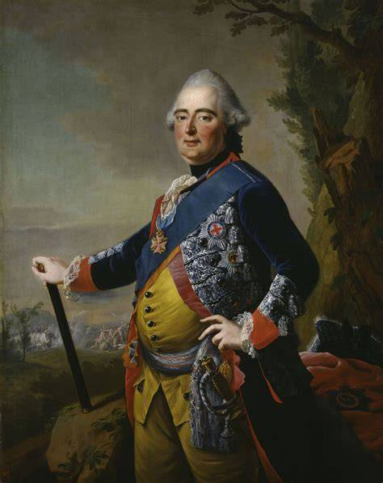
⚔️ Portrait Of Frederick II, Landgrave Of Hesse Kassel
ΦΙΛΑΔΕΛΦΙΑ
His fathers reign was marked by frugality, efficiency, and a harsh temperament. He clashed bitterly with his son, Frederick II (later Frederick the Great), whom he punished for embracing music and French culture. Despite personal cruelty, Frederick William laid the administrative and military foundations that enabled Prussia’s rise as a European power. His legacy was one of iron discipline, state reform, and relentless focus on national strength.

Slide 85
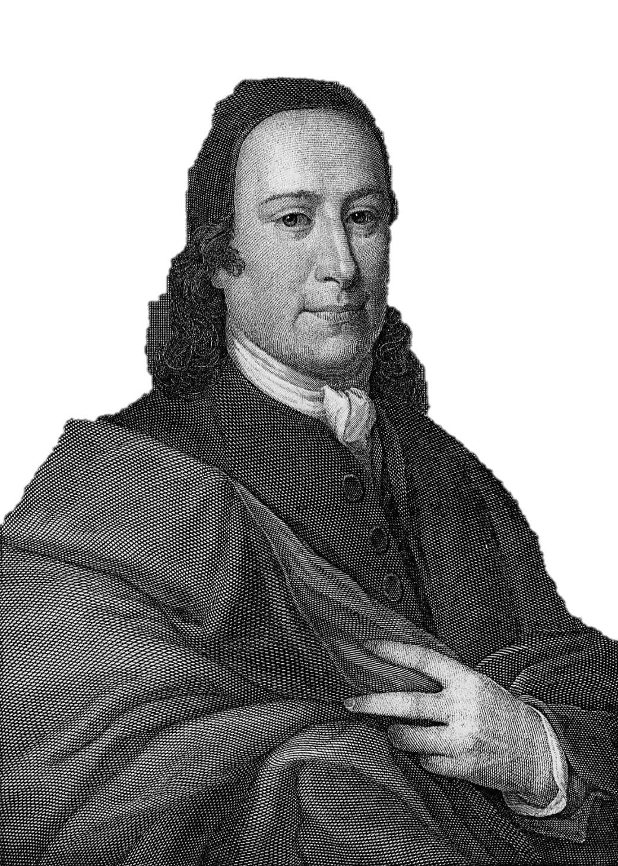
Nikolaus Ludwig Graf von Zinzendorf (1700–1760)
ΦΙΛΑΔΕΛΦΙΑ
was a German count, religious and social reformer, and bishop of the Moravian Church. He was a key leader in the Pietist movement and founded the Herrnhuter Brüdergemeine (Moravian Church), pioneering Christian missions and ecumenical Protestantism. Zinzendorf provided refuge for persecuted Moravian exiles at Herrnhut, emphasized “heart religion,” and inspired global missionary work. He was known for his simple lifestyle, deep devotion to Christ, and influential hymns. His legacy includes promoting community-based Christianity, cross-cultural missions, and spiritual renewal within Protestantism.

Slide 86
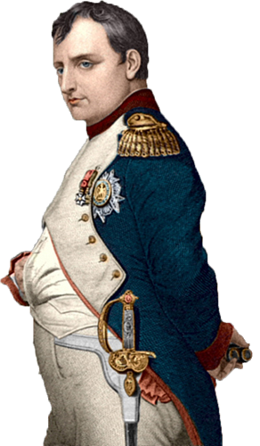
Napoleon I General and Emperor of France
in 1796, during the French Revolutionary Wars, Napoleon's troops had invaded Rome and took the pontiff, Pope Pius VI, as prisoner to France, where he died in 1799. This time marks the end of the bloody rulership of the roman church.
Napoleon invaded several times the Papal
state and arrested the pope Pius VII also.
Again, it shows how God can use holy or unholy men to end the horrible catholic persecution against the holy bride of Yeshua

Slide 87
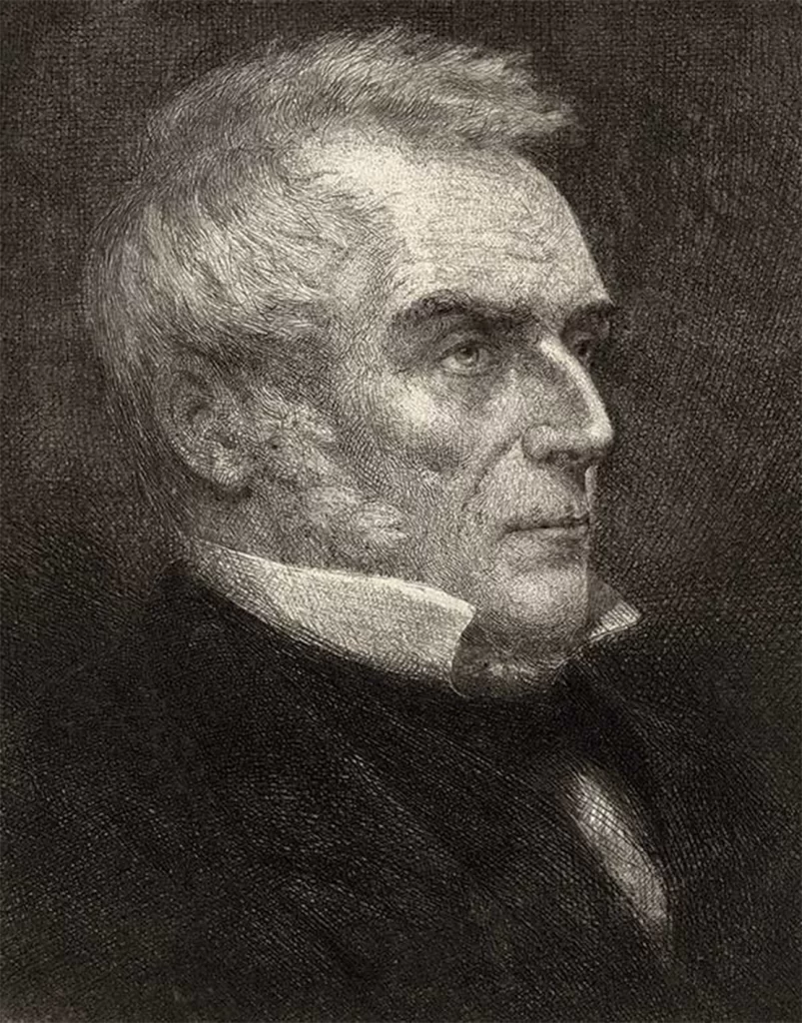
Plymouth Brethren
Began in 1831 in England and Ireland.
John Nelson Darby –
Key founder, influential theologian, and promoter of rediscovered Rapture doctrine. Very strict keeping doctrine and splitting the movement 26 times.
ΦΙΛΑΔΕΛΦΙΑ

Slide 88
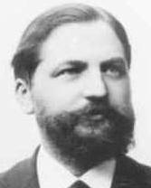
Rudolf Brockhaus 1856-1932)
ΦΙΛΑΔΕΛΦΙΑ
was born on February 13, 1856 in Elberfeld, Germany, and died on September 19, 1932 in Elberfeld. He was a notable figure in the Brethren movement, particularly associated with the Plymouth Brethren. He contributed to the spread and organization of Brethren assemblies in Germany and was known for his publishing work, which helped distribute Brethren literature and biblical teaching. His legacy is tied to strengthening the movement’s doctrinal foundations and supporting its missionary activities. See also CLV Bielefeld

Slide 89
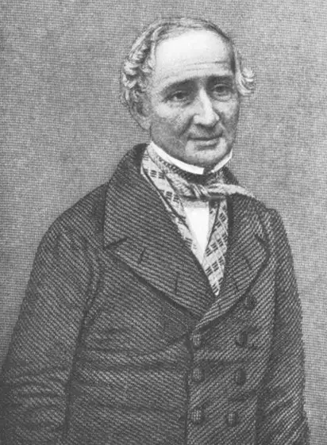
Plymouth Brethren
Began in 1831 in England and Ireland.
Anthony Norris Groves –
Often called the “Father of the Brethren Movement.”
ΦΙΛΑΔΕΛΦΙΑ

Slide 90
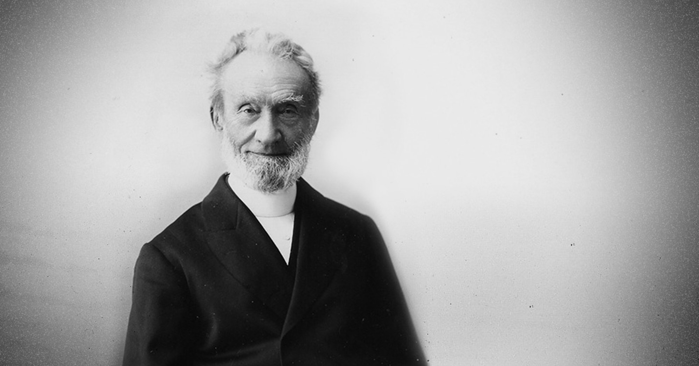
George Müller –
Known for his work with orphanages and his faith-based ministry.
ΦΙΛΑΔΕΛΦΙΑ

Slide 91
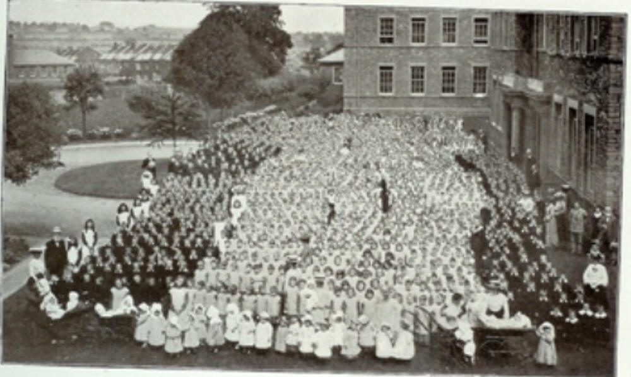
ΦΙΛΑΔΕΛΦΙΑ

Slide 92
Edward Cronin –
One of the original Dublin Brethren, pioneer of homeopathy.
John Gifford Bellett –
Early leader and writer.
Benjamin Wills Newton –
Early leader, especially in Plymouth.
George Wigram –
Organizer of the first meeting in Plymouth, biblical scholar.
ΦΙΛΑΔΕΛΦΙΑ

Slide 93
Other Notable Members
ΦΙΛΑΔΕΛΦΙΑ
Henry Craik –
Worked with George Müller in Bristol.
Robert Chapman –
Prominent among the Plymouth Brethren in the 19th century.
About many books of Theology

Slide 94
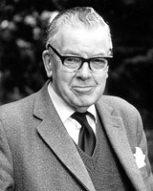
Other Notable Members
ΦΙΛΑΔΕΛΦΙΑ
Frederick Fyvie Bruce
Born: October 12, 1910, Elgin, Moray, Scotland.
Died: September 11, 1990, Buxton, Derbyshire, England
Profession: Biblical scholar, author, educator.
Major Role: Rylands Professor of Biblical Criticism and
Exegesis at the University of Manchester (1959–1978)
Education: Studied classics at the University of Aberdeen,
Cambridge University, and University of Vienna.
Christian Background: Raised in the Plymouth Brethren tradition; known for supporting the historical reliability of the New Testament [F.F. Bruce – Frederick Fyvie Bruce]
Key Works: The New Testament Documents: Are They Reliable?, Paul: Apostle of the Heart Set Free, and many commentaries on New Testament books.
Legacy: Called the “Dean of Evangelical Scholarship,” he bridged academic rigor and evangelical faith, influencing generations of scholars and Christians

Slide 95

Jim Elliot
ΦΙΛΑΔΕΛΦΙΑ
was a passionate Christian missionary who dedicated his life to spreading the Gospel. He traveled to Ecuador to reach the Huaorani people, an indigenous tribe. In 1956, he was tragically killed by tribe members, along with four other missionaries. His death inspired many to pursue missions work. Elliot’s famous quote, “He is no fool who gives what he cannot keep to gain what he cannot lose,” reflects his deep faith and sacrifice.

Slide 96
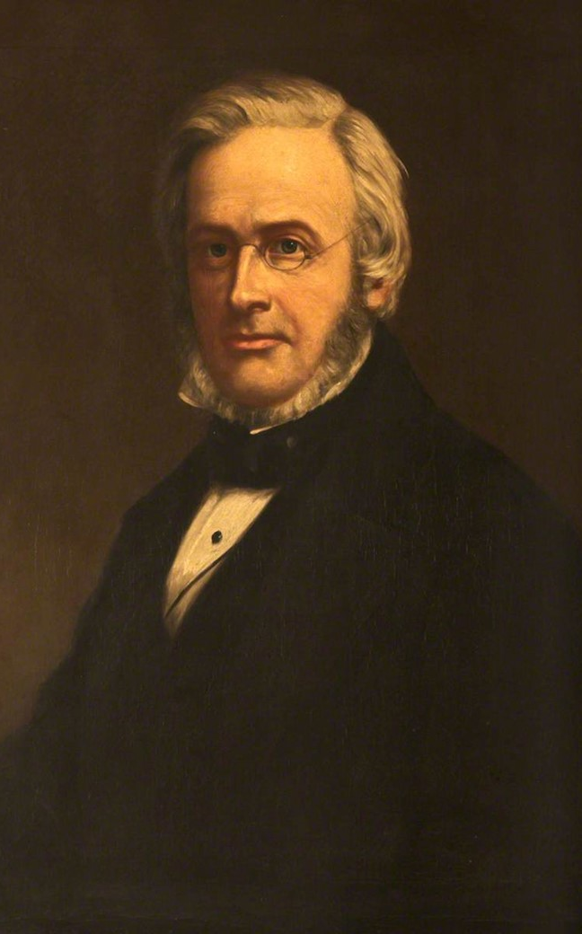
Samuel Prideaux Tregelles 1813-1875
ΦΙΛΑΔΕΛΦΙΑ
Born: January 30, 1813, Wodehouse Place, Falmouth, England. Died: April 24, 1875, Plymouth, England
Profession: Biblical scholar, textual critic, linguist, and theologian
Education: Falmouth Grammar School; largely self-taught in Greek, Hebrew, Aramaic, and Welsh.
Christian Background: Born to Quaker parents, later associated with the Plymouth Brethren, and later in life became Presbyterian or Anglican
Major Works: Produced a critical edition of the Greek New Testament, collated ancient manuscripts, and published works such as Book of Revelation in Greek (1844) and An Account of the Printed Text of the Greek New Testament (1854)
Personal Life: Married Sarah Anna Prideaux in 1839; no children
Legacy: Renowned for his scholarship in biblical textual criticism and his contributions to hymnody; received an LL.D. from St. Andrews and a civil pension for his work.

Slide 97
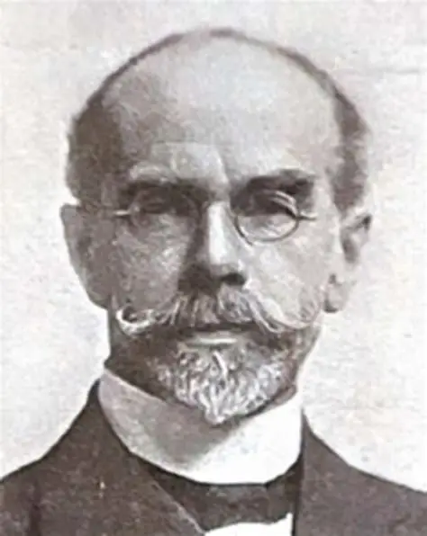
William Edwy Vine
1873-1949
ΦΙΛΑΔΕΛΦΙΑ
Born: March 21, 1873, Blandford Forum, Dorset, England Died: November 2, 1949
Profession: Biblical scholar, theologian, writer, and educator Author of Vine’s Expository Dictionary of New Testament Words, a classic reference for understanding the original Greek words in the New Testament. [en.wikipedia.org]
Education: Studied at University College of Wales (Aberystwyth) and University of London, earning a BA and MA in Ancient Classics. G.V. Wigram –

Slide 98
Episcopal Church
ΦΙΛΑΔΕΛΦΙΑ
(USA, 1776):
The American branch of Anglicanism, established after the American Revolution.

Slide 99
Loose Churches
1900 AD – Now ΛΑΟΔΙΚΕΙΑ

Slide 100
After having seen the works of a great generation a new people arose enjoying the freedom away from persecution with no need of protection by Royals.
They put emphasis on the gifts of the spirit and Prophecy. Some did this as great role models whereas others produced confusion and chaos. Many become lawless and fixed on own ideas though others prepared patiently for the return of Jesus.
Let's see some of them here
ΛΑΟΔΙΚΕΙΑ

Slide 101
19th Century Churches and Movements
ΛΑΟΔΙΚΕΙΑ
Latter Day Saint Movement (Mormons)
  Founded by Joseph Smith in 1830 in the United States. Sectarian Group with no evidence for their wretched claims in their book.
Christadelphians
  Founded in the 1840s by John Thomas in the United States and England. believe in one God, reject the Trinity, and view Jesus as God's Son but not divine. They uphold the Bible as the sole authority, practice adult baptism, and await Christ’s return to establish God’s kingdom on Earth. They reject immortal soul doctrine and emphasize personal responsibility and fellowship.
Seventh-day Adventist Church
  Officially organized in 1863, emerging from the Millerite movement in the United States. Questionable Prophecies of Ellen White
Jehovah’s Witnesses
  Originated in the 1870s as the Bible Student movement, officially adopting the name in 1931. Sectarian Group with own bible changed to their hilarious claims. Even after Israel is founded the group hold firm to their false teachings and prophecies. Jesus is not GOD in their sight.

Slide 102
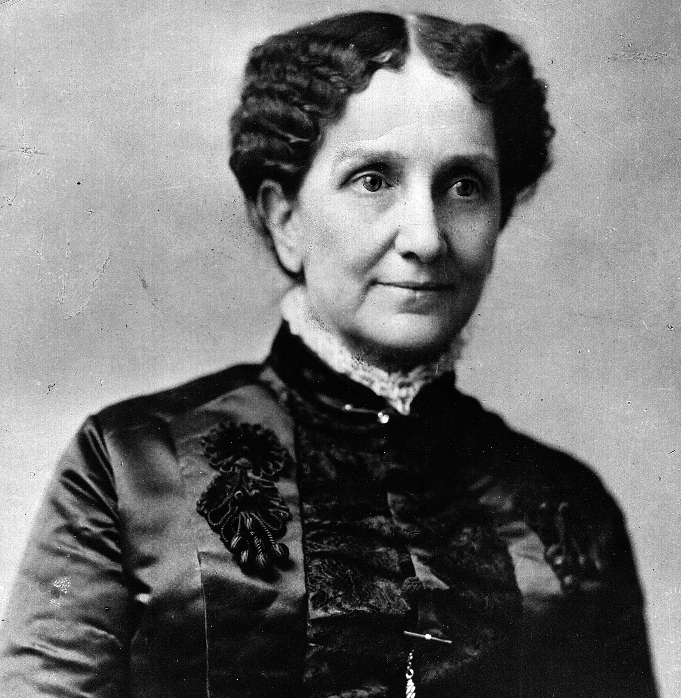
Christian Science (Church of Christ, Scientist)
ΛΑΟΔΙΚΕΙΑ
Founded by Mary Baker Eddy in 1879 in Boston, USA, teaches that spiritual understanding and prayer can heal illness. The movement rejects nowadays medicine, emphasizing the power of mind over matter. Its followers study Eddy’s book, “Science and Health with Key to the Scriptures,” and gather in Christian Science churches worldwide.

Slide 103
Pentecostals
Emerged in the early 20th century, notably with the Azusa Street Revival in Los Angeles in 1906. Various groups formed after (1914) and Oneness Pentecostalism (1913). is a nontrinitarian Christian movement emphasizing the absolute oneness of God and the full deity of Jesus Christ. It teaches baptism in Jesus’ name, the necessity of receiving the Holy Spirit with speaking in tongues, and promotes holiness in lifestyle.
Church of God in Christ
Founded in 1897, became a major African American Pentecostal denomination.
Assemblies of God
founded in April 1914 in Hot Springs, Arkansas, USA. It began as a fellowship of Pentecostal ministers and churches who gathered to organize and unify their efforts in missions, evangelism, and doctrinal clarity. Nowadays 70 million Member but is declining.
ΛΑΟΔΙΚΕΙΑ

Slide 104
African Orthodox Church
Established in 1921 in the United States.
Mount Sinai Holy Church of America
Founded in 1924.
Church of Universal Triumph, Dominion of God
Founded in 1944.
ΛΑΟΔΙΚΕΙΑ

Slide 105
Ecumenical Movement
ΛΑΟΔΙΚΕΙΑ
World Council of Churches (WCC)
  Founded in 1948 in Amsterdam, marking a major step in Christian ecumenism and unity.

Slide 106
End of Church History
types
as it was in the days of Noah
²⁶ And as it was in the days of Noe, so shall it be also in the days of the Son of man. ²⁷ They did eat, they drank, they married wives, they were given in marriage, until the day that Noe entered into the ark, and the flood came, and destroyed them all.
as it was in the days of Lot
²⁸ Likewise also as it was in the days of Lot; they did eat, they drank, they bought, they sold, they planted, they builded; ²⁹ But the same day that Lot went out of Sodom it rained fire and brimstone from heaven, and destroyed them all. ³⁰ Even thus shall it be in the day when the Son of man is revealed. ³¹ Luke 17:26-31

